Slide 1
What do you worry about? An analysis of Australia bureau of statistics mortality data⁽¹⁾
https://www.abs.gov.au/Causes-of-Death ⁽¹⁾
Notes:
WHAT IS IT THAT YOU WORRY ABOUT?
ARE THE THINGS THAT YOU WORRY ABOUT LIKELY TO HAPPEN?
HOW MUCH CONTROL DO YOU YOU ASSUME YOU HAVE OVER YOUR FATE?
THE AUSTRALIA BUREAU OF STATISTICS ANNUALLY COMPILES DETAILED DATA ON CAUSES OF DEATH. THESE CAUSES ARE ORGANIZED INTO 20 CATEGORIES, EACH WITH MANY SUBCATEGORIES. THERE ARE OVER 1500 DIFFERENT WAYS TO CLASSIFY A DEATH. ATTRIBUTES OF EACH CAUSE OF DEATH INCLUDE GENDER, TOTAL YEARS OF LOST LIFE, NUMBER OF DEATHS AND DEATH RATE. INFORMATION IS ALSO ALSO AVAILABLE FOR EACH YEAR GOING BACK TO 2009. THE DATA IS MADE AVAILABE FOR DOWNLOAD IN SPREADSHEET FORM (XLS).

Slide 2
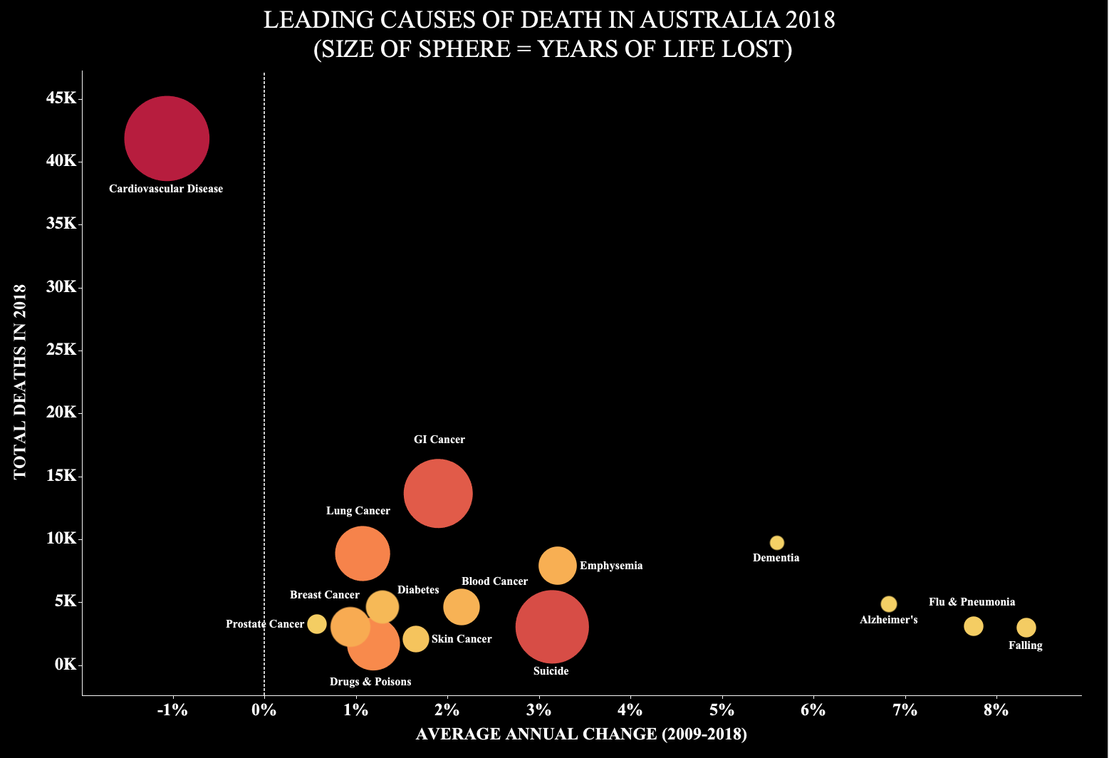

TOTAL YEARS OF LIFE LOST
Notes:
IT IS VERY COMMON FOR US TO WORRY ABOUT THINGS OUTSIDE OF OUR CONTROL – BUT LOOKING AT THIS CHART, WHAT IS MOST LIKELY TO CAUSE YOUR DEATH?
THE NUMBER ONE CAUSE OF DEATH BY A VERY LARGE MARGIN IS CARDIOVASCULAR DISEASE, WHICH IS HIGHLY INFLUENCED BY OUR DIETS AND LIFESTYLE. WE HAVE CONTROL OVER THIS THROUGH OUR DAILY CHOICES!
MANY OF THE OTHER LEADING CAUSES OF DEATH, SUCH AS LUNG CANCER, DIABETES, DRUG OVERDOSES, SKIN CANCER, AND SUICIDE, ARE ALSO HEAVILY INFLUENCED BY OUR LIFESTYLE AND CHOICES.
YOUR AGE COULD ALSO BE A SIGNIFICANT DETERMINANT OF WHAT YOU DIE FROM. IN THIS CHART THE SIZE AND COLOR OF THE SPHERE TELLS US HOW MANY TOTAL YEARS OF LIFE WERE LOST. IF A YOUNGER PERSON AND AN OLDER PERSON WERE TO DIE AT THE SAME TIME, THE YOUNGER PERSON WOULD, IN THEORY, HAVE MORE YEARS OF LIFE LEFT AND THUS WOULD HAVE LOST MORE YEARS OF LIFE. THIS EXPLAINS WHY DEMENTIA, ALZHEIMERS, AND FLU ARE SO SMALL HERE AS MOST PERSONS WHO DIE FROM THESE DISEASES ARE OLDER. IN CONTRAST, YOUNG PEOPLE ARE MORE LIKLEY TO DIE OF DRUG OVERDOSES AND SUICIDES SO THEIR SPHERES ARE LARGE EVEN THOUGH THEY ACCOUNTED FOR A RELATIVELY SMALL NUMBER OF DEATHS.
WE CAN ALSO SEE THAT SOME CAUSES OF DEATH ARE GROWING MORE QUICKLY THAN OTHERS. DEATHS DUE TO CARDIOVASCULAR DISEASE HAVE BEEN DECREASING (ON AVERAGE) WHILE DEMENTIA, FLU, FALLING, AND ALZHEIMERS HAVE BEEN INCREASING. THE INCREASE COULD BE A RESULT OF A DEMOGRAPHIC SHIFT TOWARDS AN AGING POPULATION WHERE MORE PEOPLE ARE DYING FROM THE CAUSES.
MANY OF THE THINGS THAT MOST FRIGHTEN US, SUCH AS VIOLENT CRIME, DO NOT APPEAR ON THIS LIST OF THE TOP 15 CAUSES OF DEATH. LETS NOW LOOK AT SOME OF THE LESS LIKELY CAUSES OF DEATH.

Slide 3
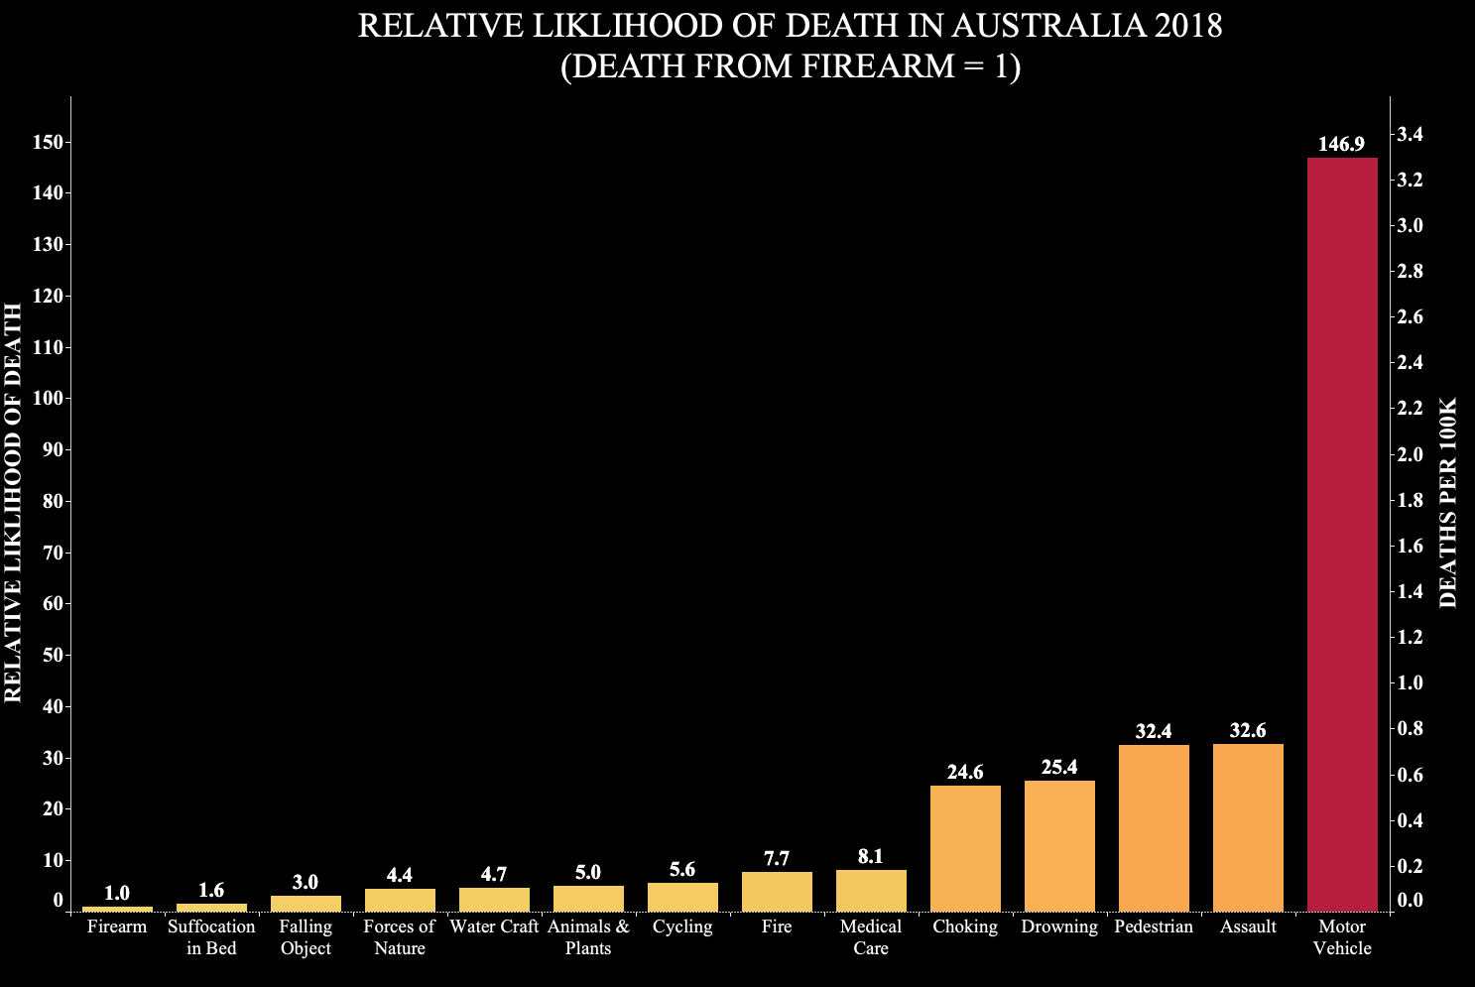
Notes:
ALTHOUGH WE MIGHT FEAR GETTING ATTACKED BY A SHARK OR BEING THE VICTIM OF A VIOLENT CRIME, THERE ARE MANY THINGS WE DO EVERYDAY THAT ARE MUCH MORE LIKLEY TO RESULT IN OUR DEATH. FOR INSTANCE, WE ARE NEARLY FIVE TIMES MORE LIKLEY TO DIE IN A CAR ACCIDENT THAN TO PERISH FROM AN ASSAULT!
MANY OF THE THINGS WE MIGHT ASSUME TO BE VERY SAFE ARE ACTUALLY QUITE DANGEROUS. WE ARE EQUALLY AS LIKELY TO DIE WALKING DOWN THE STREET AS WE ARE TO BE ASSAULTED! EATING, SOMETHING WE DO MANY TIMES A DAY, COULD LIKELY BE THE END OF US (VIA CHOKING). AND DID YOU THINK GOING TO THE HOSPITAL WAS SAFE? THINK AGAIN! YOU ARE 8 TIMES MORE LIKLEY TO DIE IN HOSPITAL THAN TO BE KILLED BY A FIREARM!
IN FACT, JUST BEING IN YOU OWN BED IS DANGEROUS! BUT KEEP ON THE LOOKOUT FOR FALLING OBJECTS OR JUST WEAR A HELMET! BUT THE BIG TAKEAWAY HERE IS TO BE CAREFUL ON THE ROADS AS DRIVING IS MOST LIKLEY THE MOST DANGEROUS ACTIVITY YOU PERFORM EACH DAY.

Slide 4
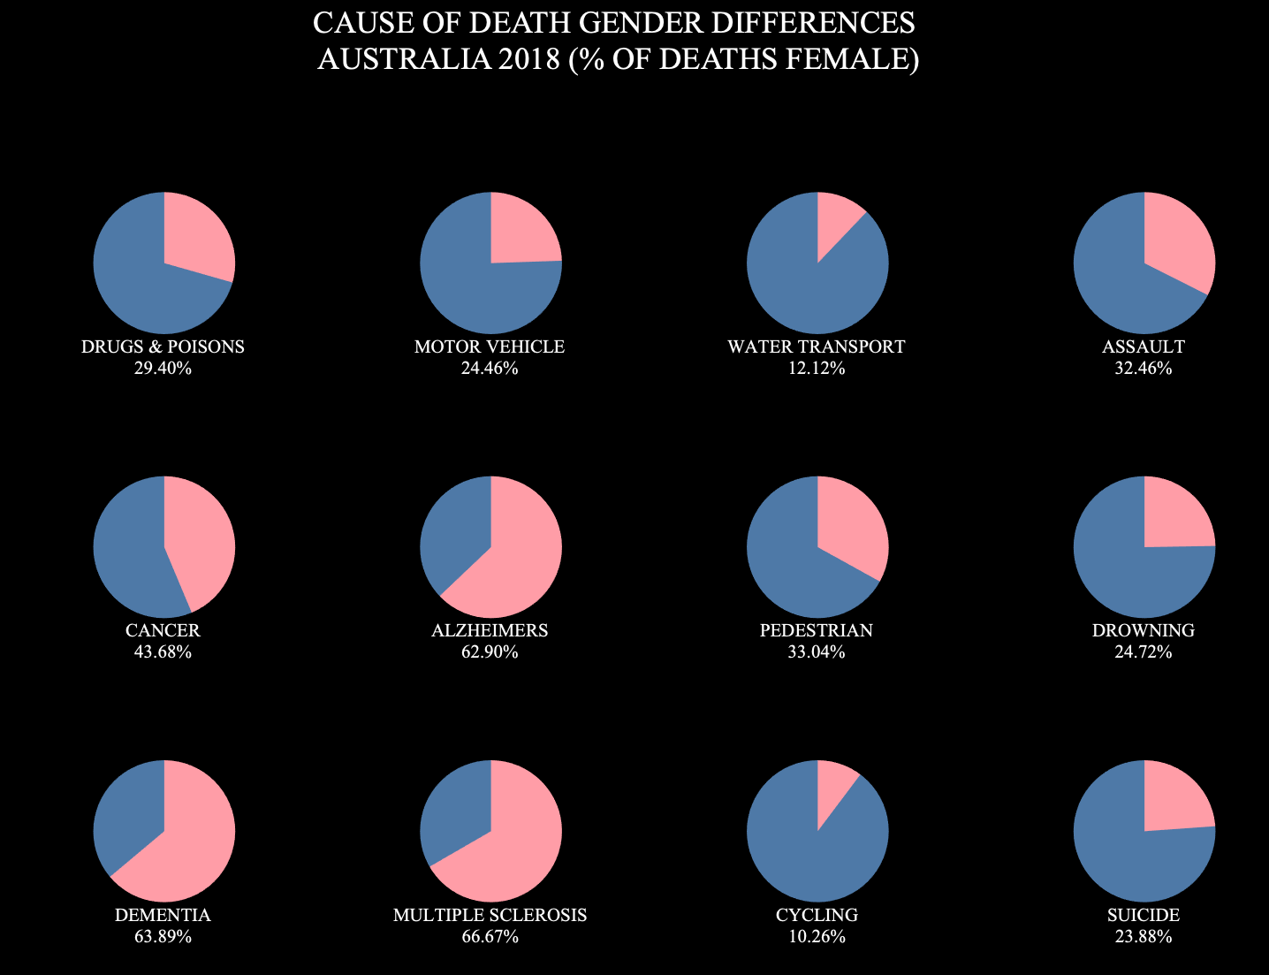

Notes:
OUR DIETS, LIFESTYLES, AND DAILY CHOICES INFLUENCE WHAT WE MIGHT DIE FROM BUT WHAT HAPPENS TO US IS ASO A PRODUCT OF WHO WE ARE GENETICALLY AND BIOCHEMICALLY.
MANY CAUSES OF DEATH HAVE VERY DIFFERENT OUTCOMES DEPENDING ON GENDER. IF YOU ARE A WOMAN, YOU HAVE AN UNUSUALLY HIGH CHANCE OF DIEING FROM MULTIPLE SCHLEROSIS, DEMENTIA OR ALZHEIMERS. BUT DON’T WORRY TOO MUCH, MEN PRETTY MUCH LEAD THE WAY IN EVERY OTHER CATEGORY! BESIDES A FEW RELATIVELY RARE DISEASES, IT LOOKS QUITE DANGEROUS TO BE A MALE. IN FACT, MORE MEN THAT WOMEN DIED IN AUSTRALIA IN 2018.
SO, WHAT ARE YOU WORRIED ABOUT? IS YOUR ANSWER THE SAME AS IT WAS THREE MINUTES AGO? PROBABLY NOT IF YOU’VE BEEN PAYING ATTENTION. ALL OF US SHOULD GIVE MORE TIME AND ATTENTION TO OUR DAILY LIFESTYLE AND DIET CHOICES AND WORRY A BIT LESS ABOUT WHAT OTHERS MIGHT DO TO US.
SO, EXERCISE, BUY MORE VEG, AND SMILE AT STRANGERS, THEY’RE PROBABLY NICE PEOPLE AND MIGHT EVEN BE NICER TO YOU THAN YOU ARE TO YOURSELF! THE MORAL OF THE STORY IS WE CAN BE OUR OWN WORSE ENEMY BUT WE ALSO HAVE THE POWER TO CHANGE THIS FOR OURSELVES WHILE POSITIVELY INFLUENCING THE DECISIONS OF OTHERS.

